Slide 1
.Net
WEB ENGINEERING

Slide 2
Week 1 - Day 4 & 5

Slide 3

Learning Objectives
By the end of this session, the students will have reinforced to further developed an understanding of:
Functions
Data Types
Operators and Arithmetic Operations
Error Handling

Slide 4
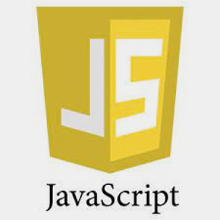
: A Quick Review
This week is focused on everyone (students with technical/non technical background) starting from the same ground with HTML & JavaScript revisions.

Slide 5
Reinforcement
What is Javascript?
What are pros and cons of Javascript Language?
what can you do with JavaScript?
What are the types of Javascript?
What are the output ways?
How do you declare variables?
What are the types of statements?
Notes:
The trainer may add more questions

Slide 6
Statements

Slide 7
Statements
JavaScript statements are composed of:
Values
Operators
Expressions
Keywords, and
Comments
Order of execution of Statements is the same as they are written.
Semicolons:
Semicolons separate JavaScript statements.
Semicolon marks the end of a statement in javascript
Notes:
https://www.geeksforgeeks.org/javascript-basic-syntax/?ref=lbp

Slide 8
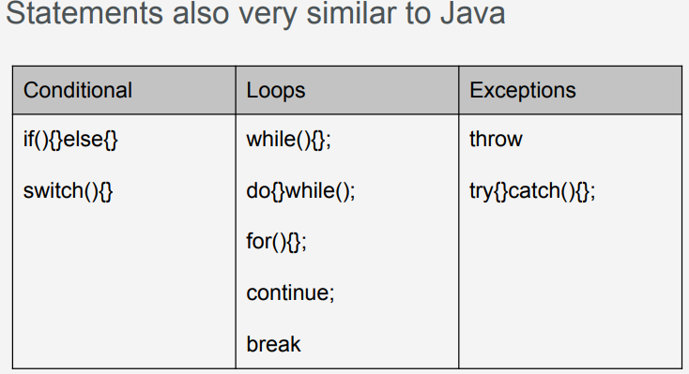
Statements

Slide 9
JavaScript - Loops
The JavaScript loops are used to iterate the piece of code using for, while, do while or for-in loops. It makes the code compact. It is mostly used in array.
There are the following types of loops in JavaScript.
for loop
while loop
do-while loop
for-in loop
continue
break

Slide 10
1- JavaScript For loop
The 'for' loop is the most compact form of looping. It includes the following three important parts −
The loop initialization where we initialize our counter to a starting value. The initialization statement is executed before the loop begins.
The test statement which will test if a given condition is true or not. If the condition is true, then the code given inside the loop will be executed, otherwise the control will come out of the loop.
The iteration statement where you can increase or decrease your counter.
You can put all the three parts in a single line separated by semicolons.

Slide 11
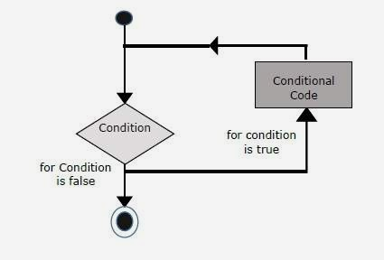
1- JavaScript For loop
Notes:
https://www.tutorialspoint.com/javascript/javascript_for_loop.htm

Slide 12
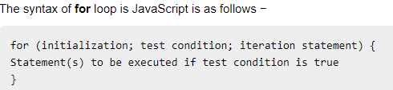
1- JavaScript For loop
Notes:
https://www.tutorialspoint.com/javascript/javascript_for_loop.htm

Slide 13
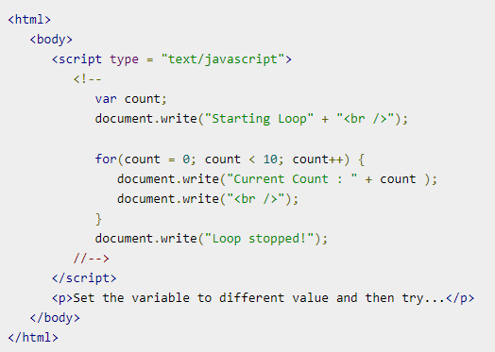
1- JavaScript For loop - Example
Try it yourself. Then tally your output with the one given on the next slide:
Check the output here.

Slide 14
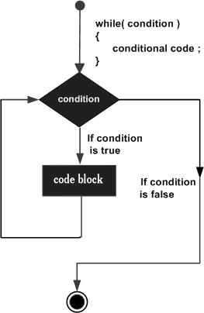
2- JavaScript while loop
The purpose of a while loop is to execute a statement or code block repeatedly as long as an expression is true. Once the expression becomes false, the loop terminates.
FlowChart
The flowchart of while loop looks as follows −
Notes:
https://www.javatpoint.com/javascript-loop

Slide 15
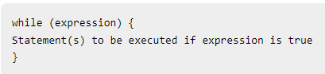
2- JavaScript while loop - Syntax
The syntax of while loop in JavaScript is as follows −
Notes:
https://www.javatpoint.com/javascript-loop

Slide 16
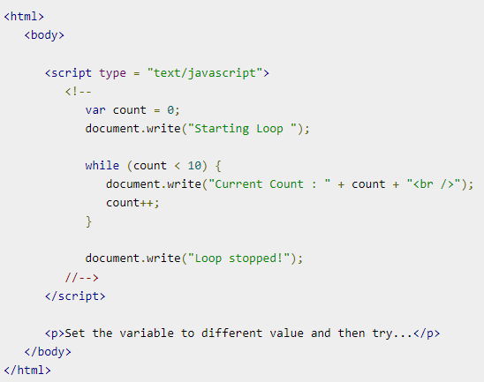
2- JavaScript while loop
Let’s see the simple example of while loop in javascript.
Check the output here.
Notes:
https://www.javatpoint.com/javascript-loop

Slide 17
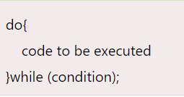
3- JavaScript do while loop
The JavaScript do while loop iterates the elements for the infinite number of times like while loop. But, code is executed at least once whether condition is true or false. The syntax of do while loop is given below.

Slide 18
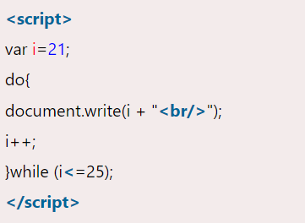
3- JavaScript do while loop
Let’s see the simple example of do while loop in javascript.
Try it yourself:
Notes:
https://www.javatpoint.com/javascript-loop

Slide 19
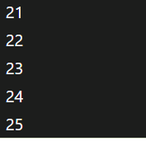
3- JavaScript do while loop
Output
Notes:
https://www.javatpoint.com/javascript-loop

Slide 20
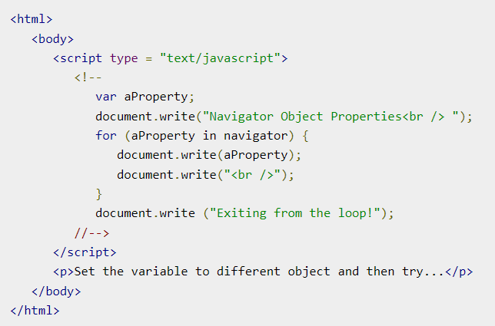
4- JavaScript for in loop - Example
Try the following example to implement ‘for-in’ loop. It prints the web browser Navigator object.
Check the result here.
Notes:
https://www.tutorialspoint.com/javascript/javascript_forin_loop.htm

Slide 21
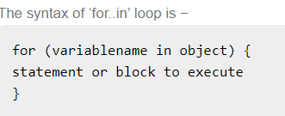
4- JavaScript for in loop
The for...in loop is used to loop through an object's properties. As we have not discussed Objects yet, you may not feel comfortable with this loop. But once you understand how objects behave in JavaScript, you will find this loop very useful.
In each iteration, one property from object is assigned to variablename and this loop continues till all the properties of the object are exhausted.

Slide 22
5- JavaScript - Loop Control
JavaScript provides full control to handle loops and switch statements.
There may be a situation when you need to come out of a loop without reaching its bottom.
There may also be a situation when you want to skip a part of your code block and start the next iteration of the loop.
To handle all such situations, JavaScript provides break and continue statements. These statements are used to immediately come out of any loop or to start the next iteration of any loop respectively.
Notes:
https://www.tutorialspoint.com/javascript/javascript_loop_control.htm

Slide 23
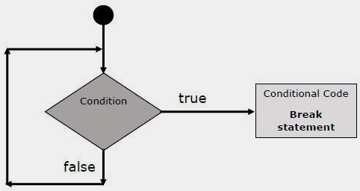
The break Statement
The break statement, which was briefly introduced with the switch statement, is used to exit a loop early, breaking out of the enclosing curly braces.
Flow Chart
The flow chart of a break statement would look as follows −

Slide 24
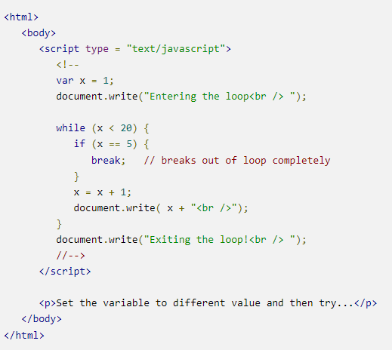
The break Statement - Example
The following example illustrates the use of a break statement with a while loop. Notice how the loop breaks out early once x reaches 5 and reaches to document.write (..) statement just below to the closing curly brace −.
Check output here.

Slide 25
The Continue Statement
The continue statement tells the interpreter to immediately start the next iteration of the loop and skip the remaining code block.
When a continue statement is encountered, the program flow moves to the loop check expression immediately and if the condition remains true, then it starts the next iteration, otherwise the control comes out of the loop.

Slide 26
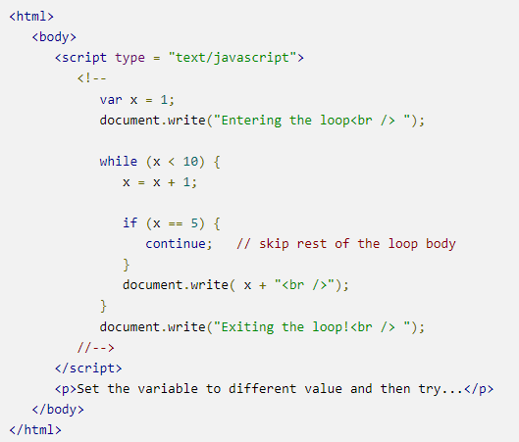
The Continue Statement
This example illustrates the use of a continue statement with a while loop. Notice how the continue statement is used to skip printing when the index held in variable x reaches 5 −

Slide 27
The Continue Statement
This example illustrates the use of a continue statement with a while loop. Notice how the continue statement is used to skip printing when the index held in variable x reaches 5 −
Check the output here.
Notes:
https://www.tutorialspoint.com/javascript/javascript_loop_control.htm

Slide 28
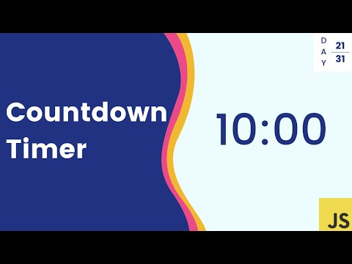
Task: Create a Simple Timer
Create the timer by watching this video.
Notes:
https://www.youtube.com/watch?v=x7WJEmxNlEs

Slide 29
Functions

Slide 30
Functions
Fundamental building blocks in JavaScript
Perform a set of statements
Calculate a value
Perform a task
Define on the scope from where you want to call it
Notes:
https://www.tutorialspoint.com/javascript/javascript_loop_control.htm

Slide 31
Functions
Fundamental building blocks in JavaScript to perform a particular task
Perform a set of statements
Calculate a value
Perform a task
Define on the scope from where you want to call it
(A JavaScript function is executed when "something" invokes it (calls it).)
Notes:
https://www.w3schools.com/js/js_functions.asp

Slide 32
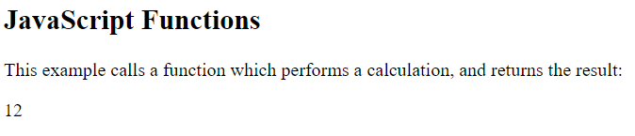
Functions - Example
Write the code to get the following output and then check the code from the link given below:
Check the output here.
Notes:
for further details about functions: https://www.w3schools.com/js/js_functions.asp

Slide 33
JavaScript Function Syntax
A JavaScript function is defined with the function keyword, followed by a name, followed by parentheses ().
Function names can contain letters, digits, underscores, and dollar signs (same rules as variables).
The parentheses may include parameter names separated by commas:
(parameter1, parameter2, ...)
The code to be executed, by the function, is placed inside curly brackets: {}
Notes:
https://www.w3schools.com/js/js_functions.asp

Slide 34

JavaScript Function Syntax
Function parameters are listed inside the parentheses () in the function definition.
Function arguments are the values received by the function when it is invoked.
Inside the function, the arguments (the parameters) behave as local variables.
A Function is much the same as a Procedure or a Subroutine, in other programming languages.
Notes:
https://www.w3schools.com/js/js_functions.asp

Slide 35
Function Invocation
Function parameters are listed inside the parentheses () in the function definition.
Function arguments are the values received by the function when it is invoked.
Inside the function, the arguments (the parameters) behave as local variables.
A Function is much the same as a Procedure or a Subroutine, in other programming languages.
Notes:
https://www.w3schools.com/js/js_functions.asp

Slide 36
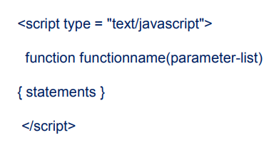
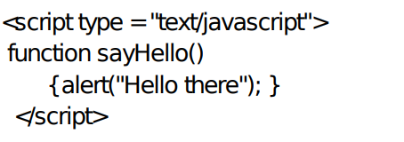
Functions
Syntax
Example
Notes:
https://www.slideshare.net/shreesenthil/javascript-basics-231170103

Slide 37
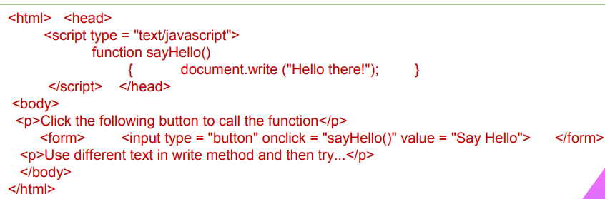
Calling a Function
Notes:
https://www.slideshare.net/shreesenthil/javascript-basics-231170103

Slide 38
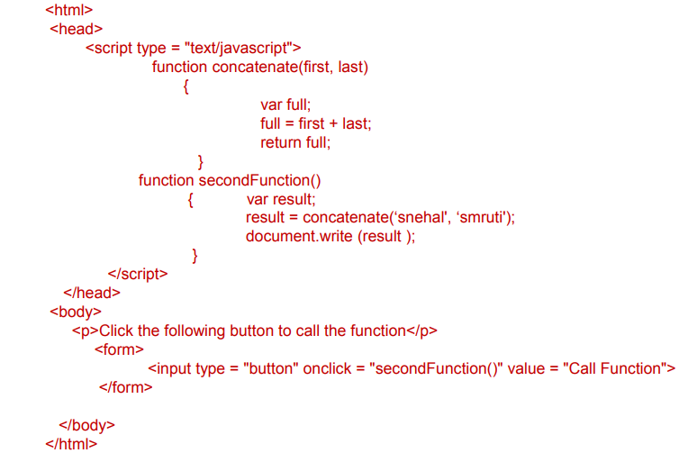
The return Statement
This is required to return a value from a function. This statement should be the last statement in a function.
Notes:
https://www.slideshare.net/shreesenthil/javascript-basics-231170103

Slide 39
Recap of Day 4
The trainer will play a musical cusion/book/paper ball segment to quickly recap day 4. The participants where the clip will stop will quickly recap a topics from the ones listed below:
The Return Statement
JavaScript Function Syntax
The Return Statement

Slide 40
Day 5

Slide 41
Data Types

Slide 42
Data Types
There are two types of Data Types in JavaScript
– Primitive data type
– Non-primitive (reference) data type
JavaScript has dynamic types. This means that the same variable can be used to hold different data types:

Slide 43
Primitive data type
String
Number
Boolean
Null
Undefined

Slide 44
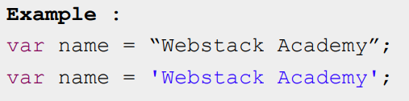
Primitive data type (String)
A series of characters enclosed in quotation marks either single quotation marks ( ' ) or double quotation marks ( " )

Slide 45
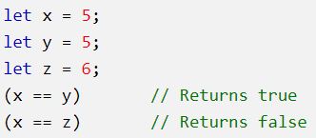
JavaScript Booleans
Booleans can only have two values: true or false. Booleans are often used in conditional testing.
Example
Execute the example and check the output here.
Notes:
https://www.w3schools.com/js/js_datatypes.asp

Slide 46

JavaScript Arrays
JavaScript arrays are written with square brackets.
Array items are separated by commas.
The following code declares (creates) an array called cars, containing three items (car names):
Example
check the output here.
Array indexes are zero-based, which means the first item is [0], second is [1], and so on.
You will learn more about arrays later in this tutorial.

Slide 47
JavaScript Objects
JavaScript objects are written with curly braces {}.
Object properties are written as name:value pairs, separated by commas.
Example
Check the output here.
The object (person) in the example above has 4 properties: firstName, lastName, age, and eyeColor.
Notes:
https://www.w3schools.com/js/js_datatypes.asp

Slide 48
Undefined
In JavaScript, a variable without a value, has the value undefined. The type is also undefined.
Example:
Check the output here.

Slide 49
Undefined
Any variable can be emptied, by setting the value to undefined. The type will also be undefined.
Example:
Check the output here.

Slide 50
Operators

Slide 51

Primitive Data Type (Numbers)
JavaScript has only one type of numbers.
Numbers can be written with, or without decimals:
Example
Execute the example and check the output here.

Slide 52
Operators
JavaScript supports the following types of operators.
Arithmetic Operators
Comparison Operators
Logical (or Relational) Operators
Assignment Operators
Let's have a look on all operators one by one.
Notes:
for further information about operators: https://www.javatpoint.com/javascript-operators

Slide 53
Arithmetic Operators
Sr.No. | Operator & Description
1 | + (Addition) Adds two operands Ex: A + B will give 30
2 | - (Subtraction) Subtracts the second operand from the first Ex: A - B will give -10
3 | * (Multiplication) Multiply both operands Ex: A * B will give 200
4 | / (Division) Divide the numerator by the denominator Ex: B / A will give 2
JavaScript supports the following arithmetic operators −
Assume variable A holds 10 and variable B holds 20, then −

Slide 54
Arithmetic Operators
Sr.No. | Operator & Description
5 | % (Modulus) Outputs the remainder of an integer division Ex: B % A will give 0
6 | ++ (Increment) Increases an integer value by one Ex: A++ will give 11
7 | -- (Decrement) Decreases an integer value by one Ex: A-- will give 9
Assume variable A holds 10 and variable B holds 20, then −

Slide 55
Arithmetic Operators
Try writing the code given in the example here. After writing it, check the output.
Practice Task
Notes:
https://www.tutorialspoint.com/javascript/javascript_operators.htm
https://www.w3schools.com/js/js_operators.asp

Slide 56
Comparison Operators
The JavaScript comparison operator compares the two operands. The comparison operators are as follows:
Operator | Description | Example
== | Is equal to | 10==20 = false
=== | Identical (equal and of same type) | 10==20 = false
!= | Not equal to | 10!=20 = true
!== | Not Identical | 20!==20 = false
> | Greater than | 20>10 = true
>= | Greater than or equal to | 20>=10 = true
< | Less than | 20<10 = false
<= | Less than or equal to | 20<=10 = false
Notes:
https://www.tutorialspoint.com/javascript/javascript_operators.htm

Slide 57
Comparison Operators
Try writing the code given in the example here. After writing it, check the output.
Practice Task
Notes:
https://www.tutorialspoint.com/javascript/javascript_operators.htm
https://www.javatpoint.com/javascript-operators

Slide 58
Logical Operators
The following operators are known as JavaScript logical operators.
Operator | Description | Example
&& | Logical AND | (10==20 && 20==33) = false
|| | Logical OR | (10==20 || 20==33) = false
! | Logical Not | !(10==20) = true

Slide 59
Logical Operators
Try writing the code given in the example here. After writing it, check the output.
Practice Task

Slide 60
Assignment Operators
The following operators are known as JavaScript assignment operators.
Operator | Description | Example
= | Assign | 10+10 = 20
+= | Add and assign | var a=10; a+=20; Now a = 30
-= | Subtract and assign | var a=20; a-=10; Now a = 10
*= | Multiply and assign | var a=10; a*=20; Now a = 200
/= | Divide and assign | var a=10; a/=2; Now a = 5
%= | Modulus and assign | var a=10; a%=2; Now a = 0

Slide 61
Assignment Operators
Try writing the code given in the example here. After writing it, check the output.
Practice Task

Slide 62
Errors & Exceptions Handling

Slide 63
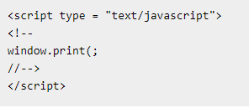
Syntax Errors
Find out the reason that why does the following line causes a syntax error:
Notes:
Answer: the following line causes a syntax error because it is missing a closing parenthesis. https://www.tutorialspoint.com/javascript/javascript_error_handling.htm

Slide 64
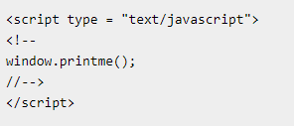
Runtime Errors
Find out the reason that why does the following line causes a runtime error
Notes:
The line causes a runtime error because here the syntax is correct, but at runtime, it is trying to call a method that does not exist.

Slide 65
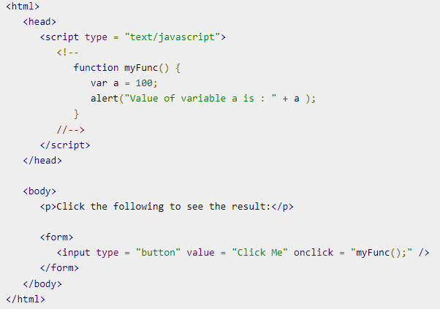
Logical Errors:
The try...catch...finally Statement
1
Here is an example where we are trying to call a non-existing function which in turn is raising an exception. Let us see how it behaves without try...catch−
Try writing this code and then tally your output.
Check the output here.

Slide 66
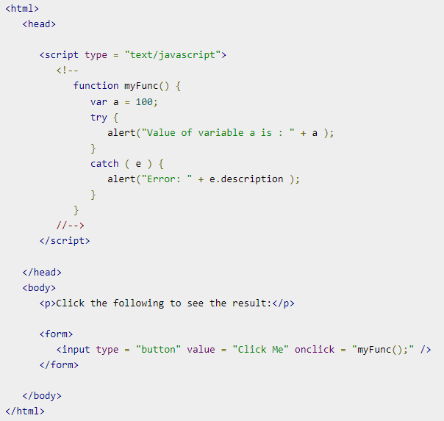
2
Now let us try to catch this exception using try...catch and display a user-friendly message. You can also suppress this message, if you want to hide this error from a user.
Try writing this code and then tally your output.
Check the output here.

Slide 67
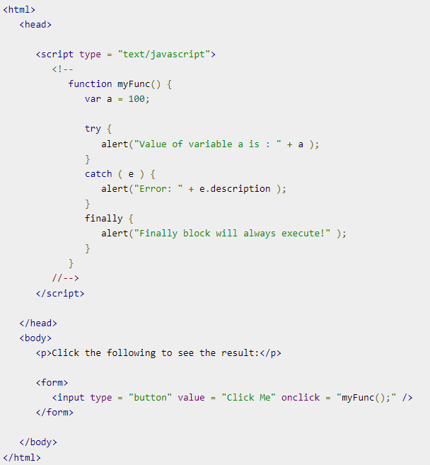
3
You can use finally block which will always execute unconditionally after the try/catch. Here is an example.
Try writing this code and then tally your output.
Check the output here.
Notes:
https://www.tutorialspoint.com/javascript/javascript_error_handling.htm

Slide 68
The Throw Statement
You can use throw statement to raise your built-in exceptions or your customized exceptions.
Later these exceptions can be captured and you can take an appropriate action.

Slide 69
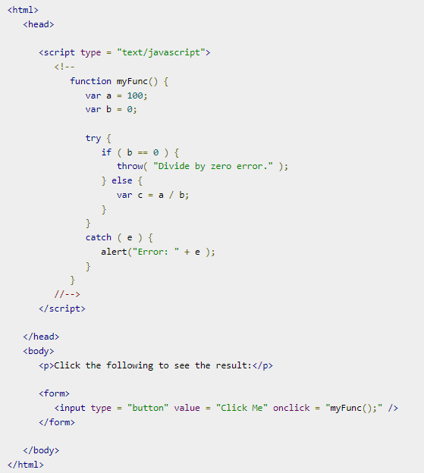
The Throw Statement
This example demonstrates how to use a throw statement.
Try writing this code and then tally your output.
Check the output here.

Slide 70
The onerror() Method
The onerror event handler was the first feature to facilitate error handling in JavaScript.
The error event is fired on the window object whenever an exception occurs on the page.
Notes:
https://www.tutorialspoint.com/javascript/javascript_error_handling.htm

Slide 71
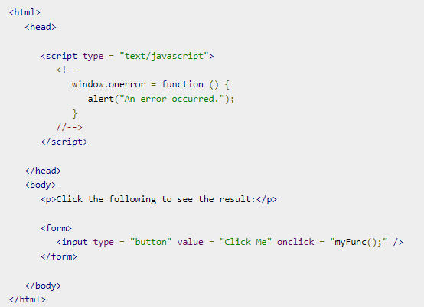
The onerror() Method
Try writing this code and then tally your output.
Check the output here.

Slide 72
The onerror() Method
The onerror event handler provides three pieces of information to identify the exact nature of the error −
Error message − The same message that the browser would display for the given error
URL − The file in which the error occurred
Line number− The line number in the given URL that caused the error

Slide 73
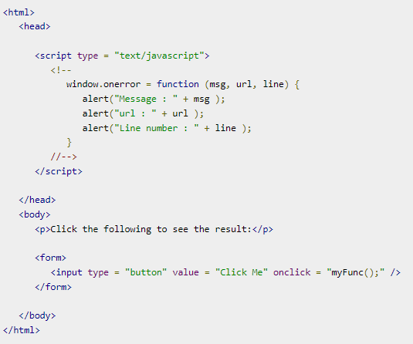
The onerror() Method
Here is the example to show how to extract this information.
Try writing this code and then tally your output.
Check the output here.

Slide 74

Homework
1- Students will practice exercises of the topics covered today from this link:
JavaScript Exercises
2- They will develop a multiplication table with the help of this link.
They will come prepared for a marked quiz to be held in the next class.

Slide 75
Reinforcement Tutorial
This tutorial can be shared with the students for further practice and reinforcement: https://www.guru99.com/interactive-javascript-tutorials.html

Slide 76

Learning Objectives
By the end of this session, the students have practised
Functions
Data Types
Operators and Arithmetic Operations
Error Handling

Slide 77
Conclusion & Q/A
See you tomorrow!

